Slide 1

COMP30220
Distributed Systems: Week 3

Slide 2

Core Topics Covered
Service-Oriented Architecture
Web Services
Jax-WS

Slide 3
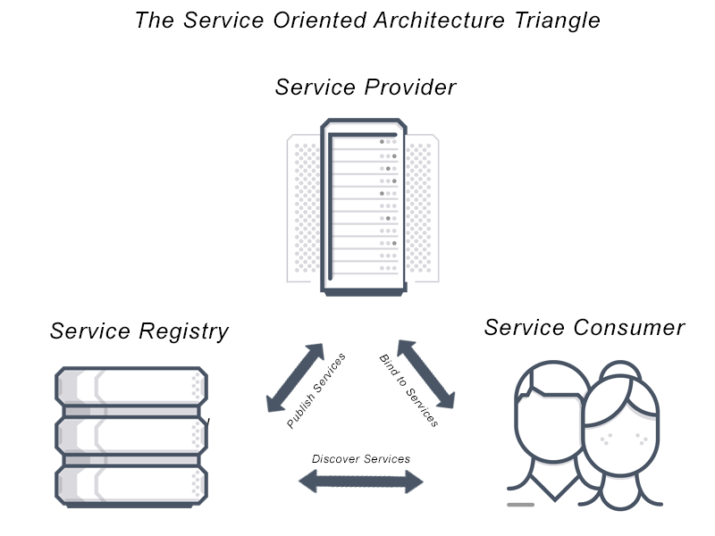
Service Oriented Architecture
Architectural Style for building systems
Business-oriented Approach:
Identify Business Processes
Decompose into Tasks
Implements Tasks as Services
Key SOA Roles
Service Provider
Service Consumer
Service Registry
Key Concept: Standardised Service Contracts

Slide 4

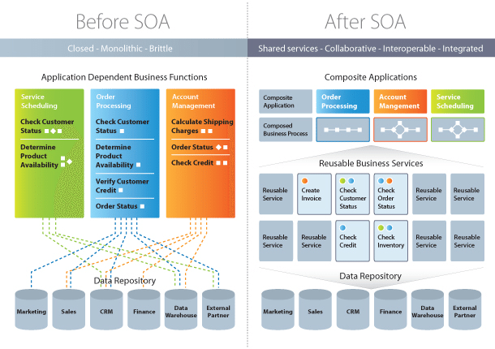
Service-Oriented Architecture

Slide 5
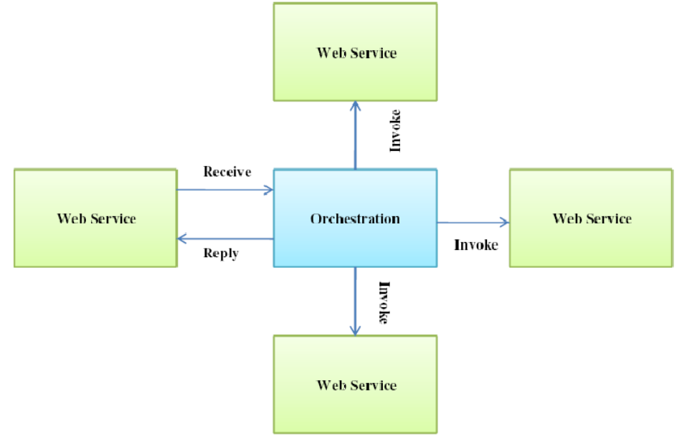
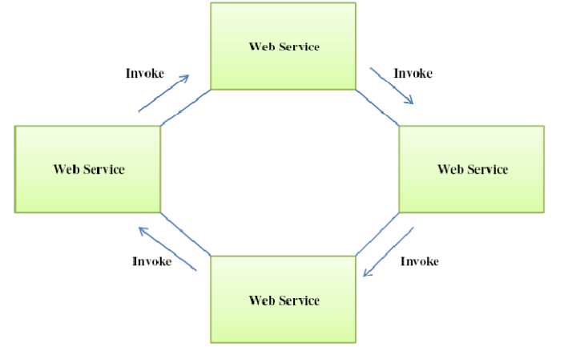
Service Composition
Service Orchestration
Service Choreography

Slide 6
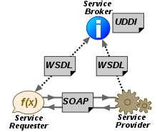
Web Services
A service that is accessible over the web
HTTP + XML
Complex Design:
Contracts: Web Services Description Language (2000 by Microsoft)
Messages: Simple Object Access Protocol (released as XML-RPC in 1999 by Microsoft)
Discovery: Universal Description Discovery and Integration (2000 by Microsoft + IBM)
…
Standards based (W3C)
Language Independent

Slide 7
WSDL 1.1
definitions
Abstract
Section
types
messages
portType
operation
input
Concrete
Section
output
binding
service
port

Slide 8
WSDL 1.1
Method: double getStockQuote(String stockName)
<definitions>
<message name=“GetStockPriceRequest”> <part name=“StockName” type=“xs:string”/> </message>
<message name=“GetStockPriceResponse”> <part name=“Price” type=“xs:double”/> </message>
<portType name=“StockQuotePortType”> <operation name=“GetStockPrice”> <input message=“GetStockPriceRequest”> <output message=“GetStockPriceResponse”> </operation> </portType>
<binding name=“StockQuoteBinding” type=“tns:StockQuotePortType”> <soap:binding style=“rpc” transport=“http://schemas.xmlsoap.org/soap/http”/> <operation name=“GetStockPrice”> <soap:operation soapAction=“http://stock.org/GetStockPrice”/> <input><soap:body use=“literal”/></input> <output><soap:body use=“literal”/></output> </operation> </binding>
<service name=“StockQuoteService”> <documentation>Really!</documentation> <port name=“StockQuotePort” binding=“tns:StockQuoteBinding”> <soap:address location=“http://stock.org/stock”/> </port> </service>
</definitions>

Slide 9
SOAP
The Request:
<soap:envelope>
<soap:body>
<GetStockQuoteRequest>
<StockName>IBM</StockName>
</GetStockQuoteRequest>
</soap:body>
</soap:envelope>
The Response:
<soap:envelope>
<soap:body>
<GetStockQuoteResponse>
<Price>123.5</Price>
</GetStockQuoteResponse>
</soap:body>
</soap:envelope>

Slide 10
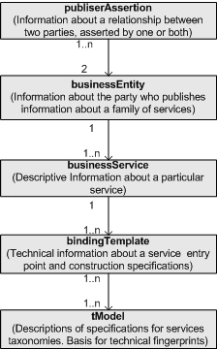
UDDI (https://juddi.apache.org/)

Slide 11
Jax-WS
A simple Java library for Web Services
Part of J2EE (and until Java 11, a core Java library)
Post Java 11, we need to add lots of dependencies to make Jax-WS work
Alternatives exist (e.g. Spring Web Services)
Supports 2 approaches to development:
Contract first: generate code based on WSDL documents (same as CORBA approach)
Program first: use annotated code to generate WSDL documents (at least for Java)
For now, we focus on the latter approach

Slide 12
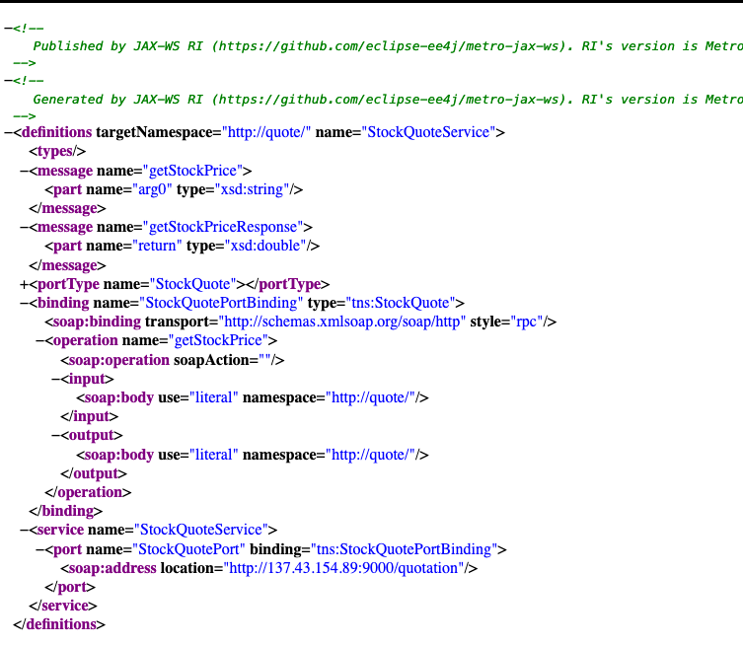
Jax-WS: Program First
@WebService
@SOAPBinding(style=Style.RPC, use=Use.LITERAL)
public class StockQuote {
private Map<String, Double> prices = new TreeMap<>();
{ prices.put("IBM", 143.79);
prices.put("GOOGL", 1209.70);
}
@WebMethod public double getStockPrice(String stockName) {
Double price = prices.get(stockName);
return price == null ? -1:price;
}
public static void main(String[] args) {
Endpoint.publish("/quotation", new StockQuote());
}
}
http://localhost:9000/quotation?wsdl

Slide 13
Jax-WS: Program First
URL wsdlUrl = new URL(”http://localhost:9000/quotation?wsdl");
QName serviceName = new QName("http://quote/", "StockQuoteService");
Service service = Service.create(wsdlUrl, serviceName);
QName portName = new QName("http://quote/", "StockQuotePort");
StockQuoteService serviceQuote = service.getPort(portName, StockQuoteService.class);
System.out.println("IBM: " + serviceQuote.getStockPrice("IBM"));

Slide 14
Note on Java + JaxWS
Java 1.8
Works out of the box
You do nothing
Java 9
Works out of the box
You do nothing
You get a deprecation warning
> Java 10
You must add dependencies…
<dependencies> <dependency> <groupId>jakarta.xml.ws</groupId> <artifactId>jakarta.xml.ws-api</artifactId> <version>2.3.3</version> </dependency> <dependency> <groupId>com.sun.xml.ws</groupId> <artifactId>rt</artifactId> <version>2.3.3</version> </dependency> </dependencies>

Slide 15
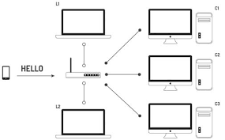
mDNS: Local Service Discovery without UDDI
Domain name resolution service for local networks
DNS packets broadcast over UDP multicast channels
Most well known application: Apple Bonjour (printer discovery service)
jmDNS: Java mDNS Library
<dependency>
<groupId>org.jmdns</groupId>
<artifactId>jmdns</artifactId>
<version>3.5.5</version>
</dependency>

